Slide 1


UNICRI Challenge 2019
True or False - Detecting video manipulation
Team HackGAN

Slide 2
Notes:
Several important peope looking like they’re trying to convince you of something
But as you can guess, these are all fake
Pose a threat to political elections, financial markets, even personal attacks

Slide 3
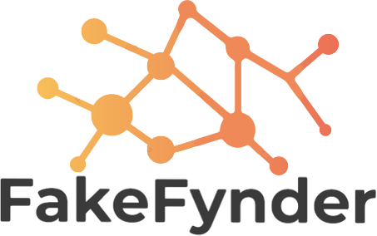
HackGAN Solution
Notes:
Faceforensics came out in march. Best performing model out there.

Slide 4
Website
Browser Plugin
Deep Fake Logging
Open API

Slide 5
Website
Notes:
No need to train new staff, as easy as drag-and-drop. Just works

Slide 6
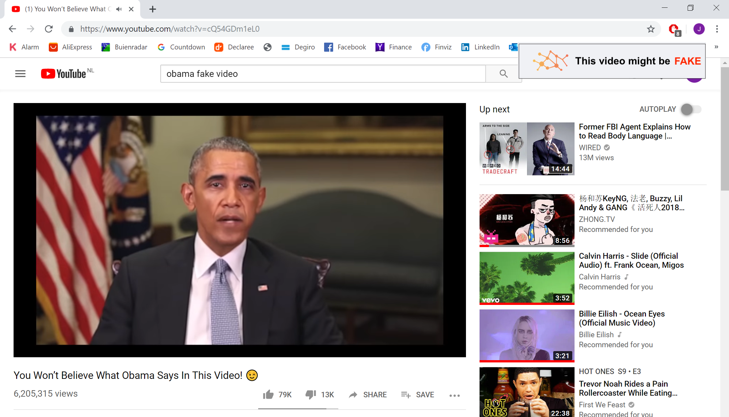
Browser Plugin

Slide 7
Deep Fake Logging
Track trending fake videos
Check videos with news outlets
Efficient use of compute resources
Notes:
Track trending fake video’s
Use this form of crowd knowledge to see which video’s are tested a lot, give this as feedback to users
Efficient use of compute resources
Fynding fakes is a time consuming process

Slide 8
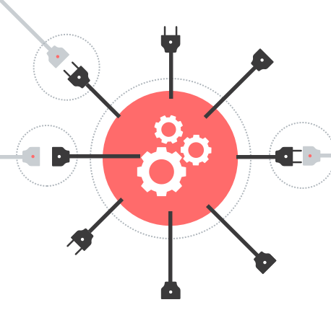
Open API
Detection technology for the public
Developers can build new features
Notes:
Iedereen filmpjes kan sturen, mensen vertellen dan dat mensen erov
Zorgt ervoor dat je via het internet verbinding kan maken met ML technologie om een antwoord te krijgen of iets een fake is of niet
Checked with the license

Slide 9
What works so far
Working:
API
Website
Deep Fake Logging
Work in progress:
Plugin

Slide 10
Closing remarks
SOTA deep fake detection for everyone
Platform to let the community develop new features
www.fakefynder.com:5000
Notes:
We are all AI enthusiasts. We met through a study group, and we see the potential danger for society that deepfakes can have.
Now more than ever it is important that we offer both governmental and private organisations, and the general public the tools to help distinguish the truth from fiction
UNICRI is a special position to combat this problem, and we would feel honoured and privileged to help you with that
Just to highlight the severity of the problem: all three videos I showed you were fake and were detected by FakeFynder. Thank you.

